Slide 1
Health and Safety Orientation for Visitors
Town of Grey Goose
Replace with your municipality
Replace with your logo
Notes:
Notes to the Course Developer:
Visitors are defined as persons who will not be fully escorted during their time at this work site.
Customers and students are not considered to be visitors.
There may be overlap between visitors and some contracting employers, service providers or self-employed persons.
Some ways to distinguish visitors needing this orientation from others needing a more comprehensive orientation, could be:
The reason that they are on your work site (i.e. attending meetings, classroom training)
The length of time they will be on your work site
The degree to which they will be unaccompanied during their time on your work site
Examples of visitors can include: equipment maintenance techs, auditors, OHS officers etc.
Every person entering your work site (beyond the front reception desk), other than customers and students, should receive one of the 4 types of orientation:
Employees
Contracting Employer
Volunteer
Visitor
This template considers two types of visitor orientations:
Generic – suitable for visitor orientation before visiting any of your municipal facilities
Site specific – suitable for visitor orientation before visiting a specific location/facility
The sections on Critical Hazards and Emergency Response have different slides for a Generic version compared to a Site Specific version. These slides are identified at the top left corner as either “Generic Version” or “Site Specific Version”.
Voice Over:
“Welcome to the Town of Grey Goose’s health and safety orientation for Visitors. “
“This orientation will be valid for one year.”

Slide 2
Town of Grey Goose
Visitor Orientation
Why your health and safety is important
What you need to know
Key messages (H&S Policy, Rules)
Critical hazards and controls
Incident reporting procedures
Emergency response
Visitors are anyone on our work sites who are not fully escorted during their time visiting the Town
Replace with your logo
Replace with your municipality’s definition of visitor.
Notes:
Voice Over:
“During this 2 to 3 minute health and safety orientation, we will review:
WHY your health and safety is important to us; and
WHAT you need to know while visiting our facility.
We define a visitor as any person on our work site who is not under the direct control and supervision of the Town.

Slide 3
Key Messages
Notes:
Voice over:
“Let’s start with our leadership key messages about health and safety.”

Slide 4
Word from our CAO
OPTIONAL
Insert a Visitor-specific message
Replace with your CAO; MP4
Click play to start video
Notes:
Notes to course developer:
This is an optional slide
If the municipality is hosting the Visitor Orientation in a way that allows visitors to complete the orientation before their visit or in an appropriate location away from a reception area, then the additional time needed for the visitor to watch the video, may be valuable to reinforce the message that their safety is important to the municipality.
Message from CAO or another senior figure from your organization/municipality.
The message can contain:
- “Welcome, I’m ‘insert name’ “
“Health and safety is our top priority because it protects everyone on our work sites, or who might be in the area of our operations.”
“It’s everyone’s job to perform our individual tasks with health and safety as our top priority.”
“Health and safety consists of both protecting our physical and psychological well-being.”
“I encourage you to ask questions if you are unsure of anything related to health and safety.”
“Once again welcome to the Town of Grey Goose. Please have a productive and safe visit with us.”

Slide 5
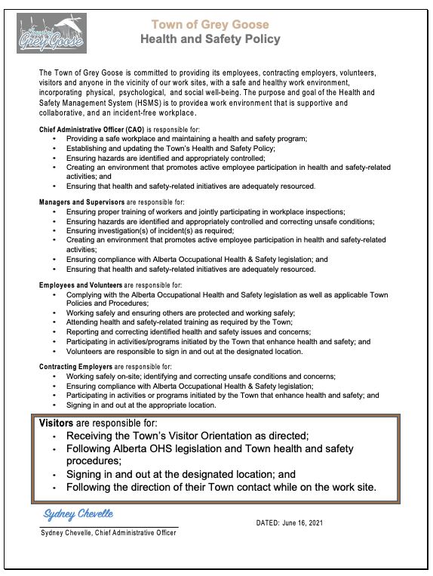
Town of Grey Goose
Health and Safety Policy
Replace with your logo
Replace with your municipality’s signed H&S Policy
Notes:
Notes to course developer:
If a video from a senior leader is not included in the orientation, the Voice Over included here should be used to provide the same/similar message as what the senior leader may have said.
If a video from a senior leader is included in the orientation, then the Voice Over for this slide can focus on the policy itself.
Voice Over:
“Health and safety is a top priority at the Town of Grey Goose because it protects everyone on our work sites or who might be in the area of our operations.”
“It’s everyone’s job to perform our individual tasks with health and safety as our top priority.”
“Health and safety consists of both protecting our physical and psychological well-being.”
“I encourage you to ask questions if you are unsure of anything related to health and safety.”
“Our Health and Safety policy has specific health and safety responsibilities for everyone who might be on our work sites: all levels of municipal employees and other parties working with Grey Goose. This policy is posted in the kitchen bullet board.
As a visitor to our Town facilities, your health and safety is important to us! During the time that you are on our work sites and could be impacted by our operations, we take our responsibility for your health and safety very seriously.
And we also want you to understand what we expect from you regarding health and safety while you are here. Your specific responsibilities include:
Receiving the Town’s Visitor Orientation as directed;
Following Alberta OHS legislation and Town health and safety procedures;
Signing in and out at the designated location; and
Following the direction of your Town contact while on the work site.”
“Once again welcome to the Town of Grey Goose. Please have a productive and safe visit with us.”

Slide 6
Town of Grey Goose
Health and Safety Rules
Zero Tolerance for:
Harassment or violence
Substance use or abuse or not fit for duty
Deliberate compromise of anyone’s physical or psychological health and safety
Replace with your logo
Replace with your municipality’s key H&S rules
Visitors may be removed from the work site for any violations
Notes:
Voice Over:
“Every person on a Town of Grey Goose work site has the right to a safe and healthy workplace, for both their physical and psychological well-being.”
“The Town is committed to providing that safe and healthy workplace and will not tolerate actions or conditions that compromise that commitment. “
”Visitors may be removed from Town of Grey Goose work sites for any instances of:
Initiating acts of harassment or violence;
Substance use, including prescription medications, that make them not fit for duty; or
Any deliberate compromise of anyone’s physical or psychological health and safety.”

Slide 7
Obligations of Workers & Visitors
Protect the health and safety of workers and other persons at or in the vicinity of the work site.
Work with your Town contact or any other person for the purpose of protecting the health and safety of others.
Use PPE when required as per OHS legislation.
Refrain from causing or participating in harassment or violence.
Report any unsafe or harmful work site conditions.
Notes:
Voice Over:
“As per Alberta’s occupation health and safety Act, each worker has obligations, and some of these extend to our visitors. They are:
To protect the health and safety of workers and other persons at or in the vicinity of the work site.
To work with your Town contact or any other person for the purpose of protecting the health and safety of others.
For you to use PPE when required as per OHS legislation.
You must refrain from causing or participating in harassment or violence. And
To report any unsafe or harmful conditions that you see on our work sites.”

Slide 8
Critical Work Site Hazards and Controls
Notes:
Notes to course developer:
The template can be used to create a generic visitor orientation for someone visiting any municipal facility or it can be used to create a visitor orientation for a specific facility.
Generic orientation uses slides 9 to 10
Facility specific orientation uses slides 11 to 12
In either case, it is recommended that this orientation be followed by a Field Level Hazard Assessment with the municipal contact at the time of the actual visit.
Voice Over:
“Now that the Town’s expectations are clear, let’s look at the critical hazards that you may face during your visit.”

Slide 9
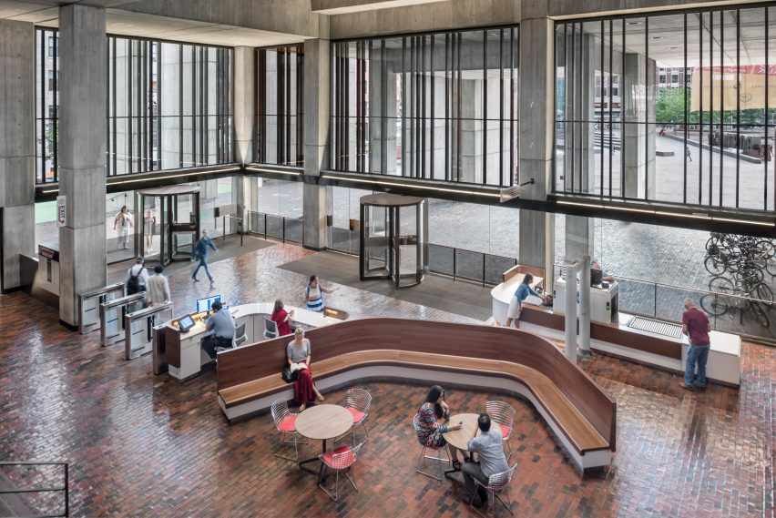
Generic Version
Town of Grey Goose
Critical Hazards and Controls
Replace with your logo
Visiting a Town Facility
Harassment
Violence
Working Alone
Emergency situation
Replace with your municipality’s critical hazards relevant for any municipal work site(s) the visitor may go to.
Notes:
Notes for the course developer:
For a generic orientation, more general critical hazards that might apply at any of the municipality’s facilities, can be identified. For instance:
Harassment
Violence
Working alone
Emergency situations
Adding an image of the main facility can help visitors identify where they should “check-in”.
Voice Over:
“While visiting any of our Town facilities, there is a potential for incidents to occur and the Town has identified hazards that may impact visitors to our facilities. We have also put specific controls in place to minimize the risk of these hazards having an impact on our work sites.”
“The 4 critical potential hazards for visitors are:
Harassment;
Violence;
Working Alone; and
An emergency situation.
“If you will be visiting our work site multiple times, changes to the working environment and hazards during your visit will be communicated by completing a daily Field Level Hazard Assessment with your Town contact.”

Slide 10
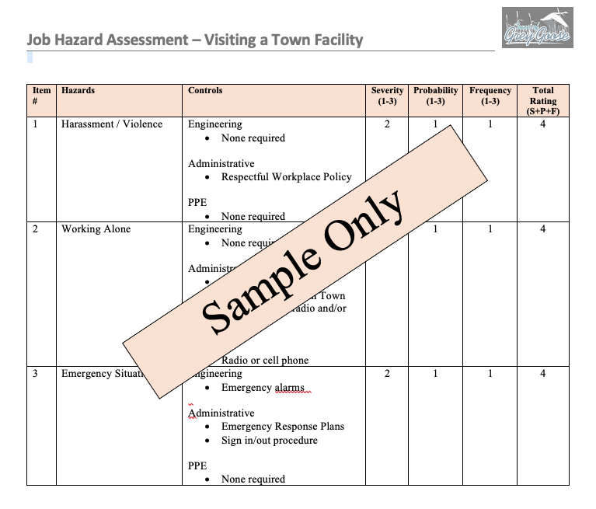
Hazard Identification, Assessment, and Control
Generic Version
Replace with your hazard identification, assessment and control forms / documents, relevant for any municipal work site(s) the visitor may go to
Notes:
Voice Over:
“There are controls in place for these 4 potential hazards.
“To prevent both harassment and violence, we have trained employees on our Respectful Workplace Policy and our safety rules have a zero tolerance for either behaviour.”
“Depending on what you will be doing while on our Town work site, you may be working alone at times, meaning that you will not always be accompanied by a Town employee. To prevent incidents if you are working alone, our procedure will be to check-in regularly by either stopping by where you are working, or by calling you on a radio or cell phone. Your Town contact will provide details at the time of your visit. You will also be required to sign in and out of our facilities each time you visit.
“If an emergency situation occurs, our Emergency Response Plan will be activated. We will discuss this in more detail in a moment.”

Slide 11
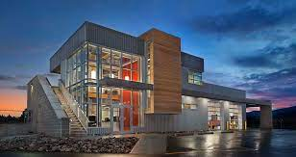
Site Specific Version
Town of Grey Goose
Critical Hazards and Controls
Replace with your logo
Visiting the Town’s Waste Water Treatment Plant
H2S release
Emergency situation
Working Alone
Replace with your municipality’s specific critical hazards relevant to the site(s) the visitor will be at.
Notes:
Notes for the course developer:
For a site specific orientation, details of facility hazards can be provided here.
Including an image of the specific facility where the person will be visiting, can be helpful for them to know they are in the right place (i.e. to meet their contact)
Voice Over:
“While visiting our Town of Grey Goose Waste Water Treatment Plant, there is a potential for incidents to occur and we have identified those that may impact visitors to this facility. We have also put specific controls in place to minimize the risk of these hazards having an impact on our work sites.”
“The 3 critical potential hazards for visitors are:
Exposure to H2S through a release;
An emergency situation; and
Working alone.
“If you will be visiting our work site multiple times, changes to the working environment and hazards during your visit, will be communicated by completing a daily Field Level Hazard Assessment with your Town contact.”

Slide 12
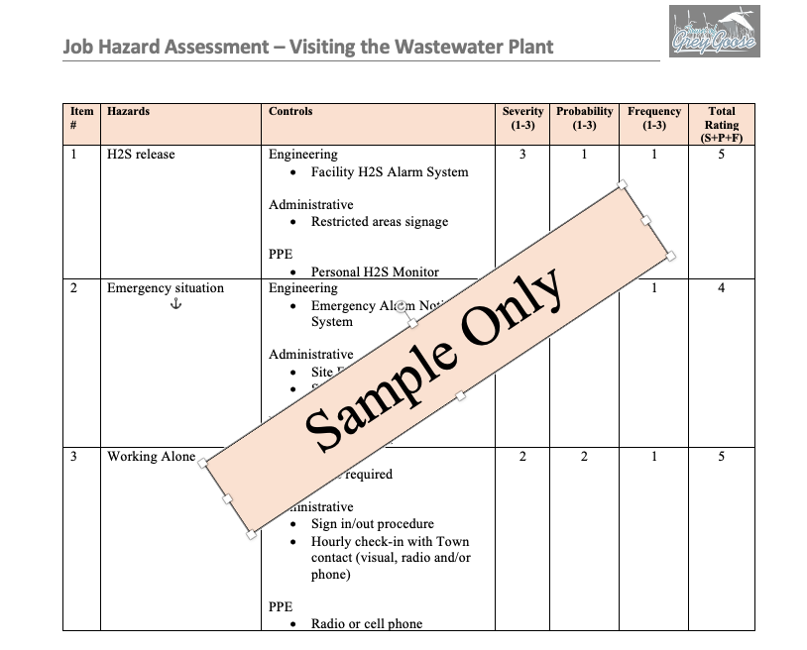
Hazard Identification, Assessment, and Control
Site Specific Version
Replace with your hazard identification, assessment and control forms / documents, for a visit to a specific facility
Notes:
Notes for the course developer:
If there is a potential for a severe incident such as an H2S release, due to the criticality, it would be helpful here to include an audio or video of that specific alarm, to help visitors differentiate it from a standard emergency alarm.
Voice Over:
“There are controls in place for these 3 potential hazards.
“We have 3 controls in place to manage the situation if there is a release of H2S.
We have an alarm system that is different from the regular emergency alarms;
Only fully trained employees are allowed into restricted areas with the highest potential for H2S exposure; and
If appropriate based on your specific activities, you will be provided with a personal H2S monitor.
“If an emergency situation occurs, our Emergency Response Plan will be activated. We will discuss this in more detail in a moment.”
“Depending on what you will be doing while on our Town work site, you may be working alone at times, meaning that you will not always be accompanied by a Town employee. To prevent incidents if you are working alone, our procedure will be to check-in regularly by either stopping by where you are working, or by calling you on a radio or cell phone. Your Town contact will provide details at the time of your visit. You will also be required to sign in and out of our facilities each time you visit.

Slide 13
Incident Reporting Procedures
Notes:
Voice Over
“Now that we’ve looked at how we work to prevent incidents, let’s look at our reporting procedures in case there is an incident while you are visiting our site.”

Slide 14
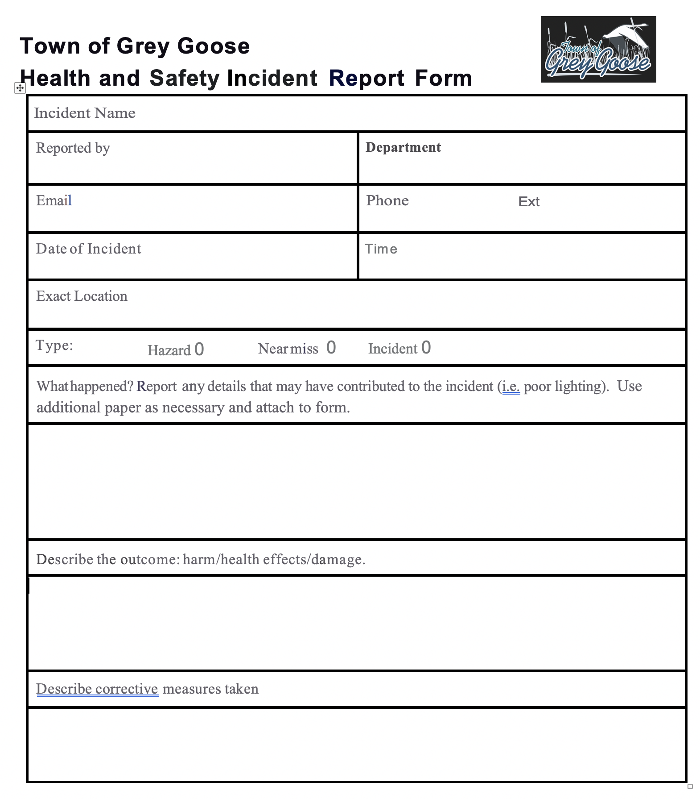
Incident Reporting
Report everything!
Any hazards you see
Near misses
All incidents
Replace with your forms / documents and requirements, for a visitor to use to report an incident
Notes:
Notes for the course developer:
Voice Over:
“At the Town of Grey Goose, we believe that preventing incidents is possible and can be improved by understanding why they happen.”
“For that reason, we expect everyone to report:
All hazards or unsafe behaviours that they see;
Any near misses that they experience even though the outcome might have been negligible or non-existent; and definitely
All incidents that occur.”
“If we don’t hear about something, we can’t correct it.”
“Your Town contact will help you with the Town’s reporting procedure and will ask for basic information about what happened. If an investigation is needed, they will make the necessary arrangements.”

Slide 15
Emergency Response
Notes:
Notes to course developer:
The template In the case of a generic orientation provided to visitors, it is recommended that the site specific emergency response plan (including recognition of the alarm system and location of the muster point & shelter in place location) is reviewed with the municipal contact at the time of the actual visit.
Voice Over
“The Town has developed Emergency Response Plans for each of our facilities, in the unlikely event that an emergency occurs. We also conduct regular emergency exercises and those could happen while you are visiting our work site.”
“Let’s look at key information that you need to know if either an exercise or activation occur.”

Slide 16
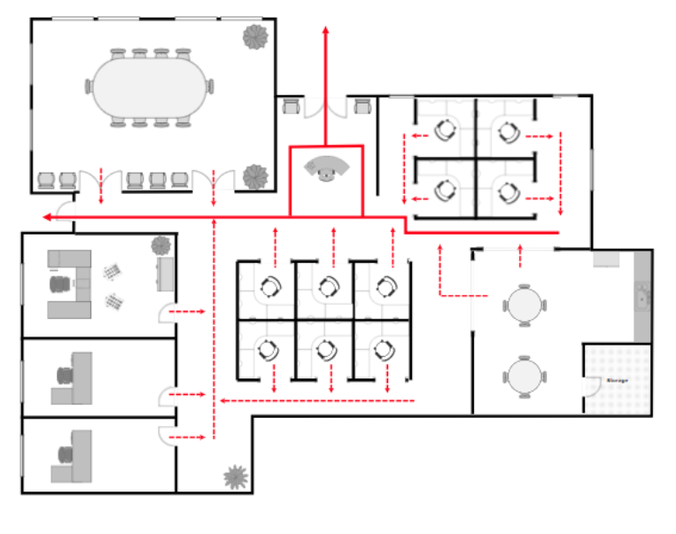
Town of Grey Goose Office Floor Map
Muster Point #1 At the Plaza Sign
Replace with your municipality.
Replace slide with your work site maps.
Muster Point #2 At the grassy knoll
 | Fire Extinguisher
 | First Aid Kit
 | Alarm Pull-down Stations
 | Health and Safety Contact List
Notes:
Notes to course developer:
The map/schematic for the specific facility should be used. For a generic orientation, a general office layout can be used.
All relevant information as identified on the Health and Safety Orientation Checklist should be included on the map/schematic:
First aid kit and AED locations
Emergency alarm pull-down station locations
Fire extinguisher locations
Shelter-in-place locations
Evacuation routes
and the
Muster Points in the event of an evacuation.
If there is a Lock Down procedure for the facility it needs to be mentioned as well.
It can be helpful to add an audio or video file to demonstrate what the emergency alarm sounds like.
Videos or images of specific muster points can also be helpful.
Voice Over:
“This is the floor map for the facility you will be visiting.
Please make sure you check the locations of the:
First aid kit and AED
Emergency alarm pull-down stations
Fire extinguishers
Shelter-in-place sites
Evacuation routes
and the
Muster Point in the event of an evacuation.
“If an emergency exercise happens while you are at our facility, follow the direction of the Emergency Warden or your Town contact.”
“In an emergency, our first priority is to protect people, so if you see an emergency, call 9-1-1."

Slide 17
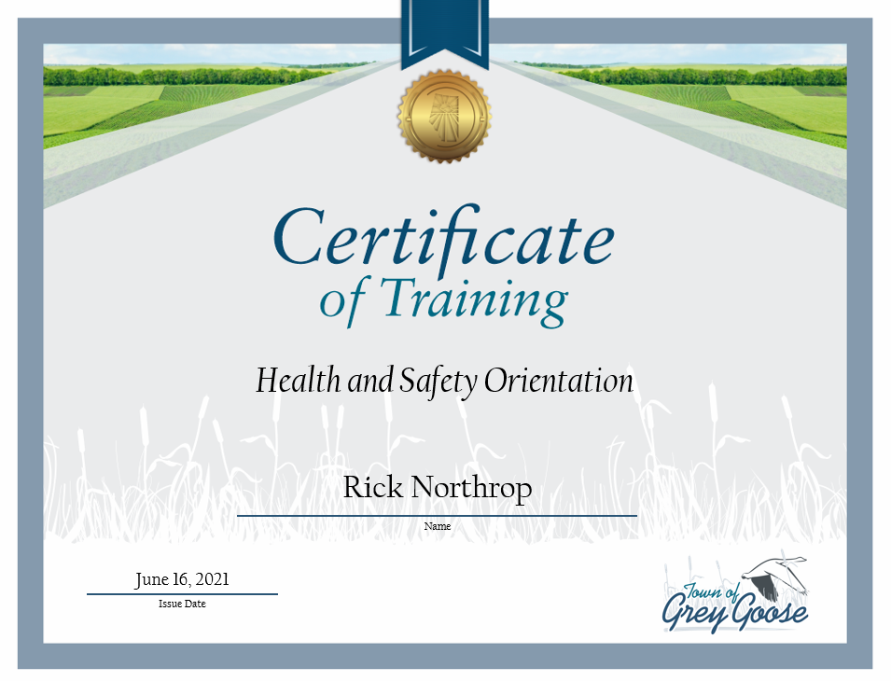
Save your certificate.
Thank you!
Replace with actual H&S Orientation certificate
Replace with your municipality’s procedure for visitors.
Notes:
Notes to the course developer:
If you would like to add questions/knowledge checks, that can be done before concluding the course. It is not a requirement, and for a course of this length it may not provide value, but it would be a way to go beyond the minimum standard.
An assessment of the process for visitors to complete the orientation and show confirmation. Common options include:
Providing a link for the course to be completed prior to the visit. How confirmation will be achieved (i.e. screen shot, record in an LMS) must be determined by the municipality.
Completing the course once on site, perhaps at the reception/front desk. In this case, the municipal contact or front desk employee can confirm completion at time of sign in.
Voice Over:
“Congratulation on completing the Town of Grey Goose Health and Safety Visitor Orientation and thank you for supporting our Health and Safety program. Please notify your Town contact that you have completed this training and check-in with them when you arrive at our facility.”
“This orientation is valid for one year from today.”
“Thank you and welcome!”

Slide 18
The End

