Slide 1
Health and Safety Orientation for Employees
Town of Grey Goose
Replace with your municipality
Replace with your logo
Notes:
Voice-over:
“Welcome to the Town of Grey Goose’s health and safety orientation. Please feel free to take note as there’s multiple choices questions at the end of this online health and safety orientation.”

Slide 2
Word from our CAO
Replace with your CAO; MP4
Click play to start video
Notes:
Message from CAO or another predominate figure from your organization/municipality.
The message can contain:
- “Welcome, I’m ‘insert name’ “
“Health and safety is our top priority because it protects you our number one asset.”
“It’s everyone’s job to perform our individual tasks with health and safety as our top priority.”
“Health and safety consist of both protecting our physically and psychologically wellbeing.”
“Once again welcome onboard, and I look forward to seeing the positive health and safety impacts you contribute to the Town of Grey Goose.”

Slide 3
Health and Safety Online Orientation
Why is your health and safety important?
What is the data showing us?
Your role in health and safety.
What you need to know.
Notes:
Voice-over:
“During this online health and safety orientation we'll go over WHY health and safety orientation is important by reviewing:
Why your health and safety is important.
What the data is showing us.
Your role in health and safety.
What do you need to know.”

Slide 4
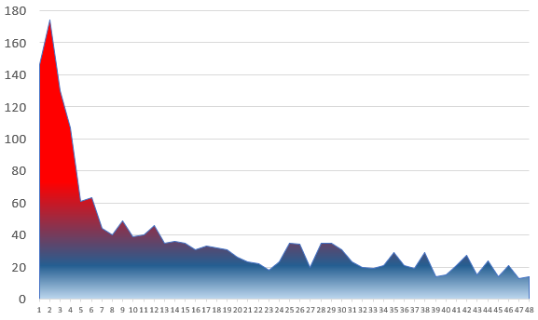
Municipal Workers are 400% More Likely to be Injured in the First Four Months
Data
49% are “Young Workers” (24 years old or less)
17% are 18-19 years old
As many claims happen in the first four months as happen in the next 12.
As many claims happen in the first year as happen in the next 3 years.
13% are seasonal workers
Number of injuries
Replace with your municipality’s data
Number of months on the job
Notes:
Voice-over
“According to this data provided by ‘Alberta WCB Municipal Specific Claims Data 2017-2021’. Workers are 400% more likely to be injured in the first four month.
Almost ½ of the workers injured are considered young workers. (Also, important to consider that ½ aren’t “young workers”. More mature workers are at risk as well.)
As many claims occur in the first four months as the following 12
As many injuries happen in the first year as the total of years 2-5.”
13% of the injuries are to seasonal workers. That seems like a small number, but it is likely more considerable as it is unlikely that 13% of the workforce is made up of seasonal workers.”

Slide 5
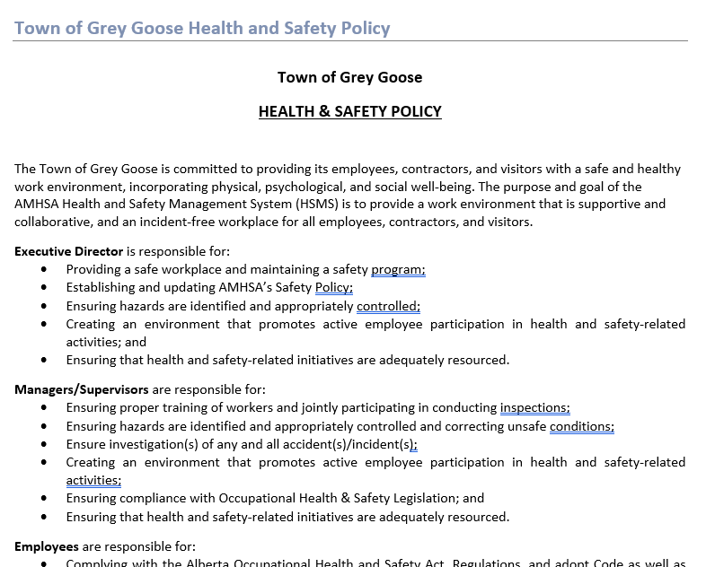
Town of Grey Goose
Health and Safety Policy
Replace with your logo
Replace with your municipality’s signed H&S Policy
Notes:
Voice over:
“This policy has specific health and safety responsibilities for all levels of municipal employees and other parties working with Grey Goose. This policy is available both in the health and safety manual and it is posted in the office kitchen bullet board.”

Slide 6
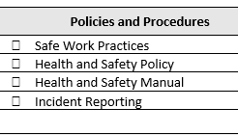
Health and Safety Policy and Procedures
Replace with your specific terms and list of policies and procedures.
Replace with your logo
Notes:
Voice-over
“The Health and Safety Policy that is signed by our CAO can be found in our Health and Safety manual. This manual has safe work practices and other roles and responsibilities.
A dedicated copy is in the kitchen and is also found on our intranet site under the Health and Safety tab.”

Slide 7
Town of Grey Goose
Policies and Procedures
Emergency Management
Hazard Identification, Assessment, and Control
Health and Safety Committee and Health and Safety Representative
Health and Safety Records Management
HSMS Employee Accountability and Performance Review
Incident Investigation
Journey Management
Musculoskeletal Injury (MSI) Prevention
Replace with your logo
Replace with your municipality’s policies and procedures.
Notes:
Voice over:
“This a list of subjects found the in the health and safety manual.
Emergency Management
Hazard Identification, Assessment, and Control
Health and Safety Committee and Health and Safety Representative
Health and Safety Records Management
HSMS Employee Accountability and Performance Review
Incident Investigation
Journey Management
Musculoskeletal Injury (MSI) Prevention”

Slide 8
Town of Grey Goose
Policies and Procedures
Onboarding, Training, and Competency
Psychological Health and Safety
Working Alone
Workplace Abuse, Violence, and Harassment Prevention
Workplace Inspections
Visitors and Other Parties on the Work Site
Replace with your logo
Replace with your municipality’s policies and procedures.
Notes:
Voice over:
“Continuing down the list of policies and procedures we have:
Onboarding, Training, and Competency
Psychological Health and Safety
Working Alone
Workplace Abuse, Violence, and Harassment Prevention
Workplace Inspections, and
Visitors and Other Parties on the Work Site.
Please be familiar with your roles and responsibilities. Your Supervisor and Team Lead will provide you support with all work-related tasks and conditions related to these policies and procedures.”

Slide 9
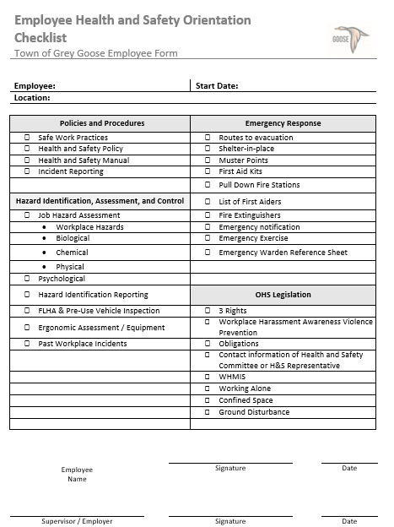
Health and Safety Orientation Checklist
Replace slide with your checklist
Notes:
Voice over:
“After seeing the broad view of what health and safety program involves, we’ll use this health and safety orientation checklist to guide us through the health and safety topics.”

Slide 10
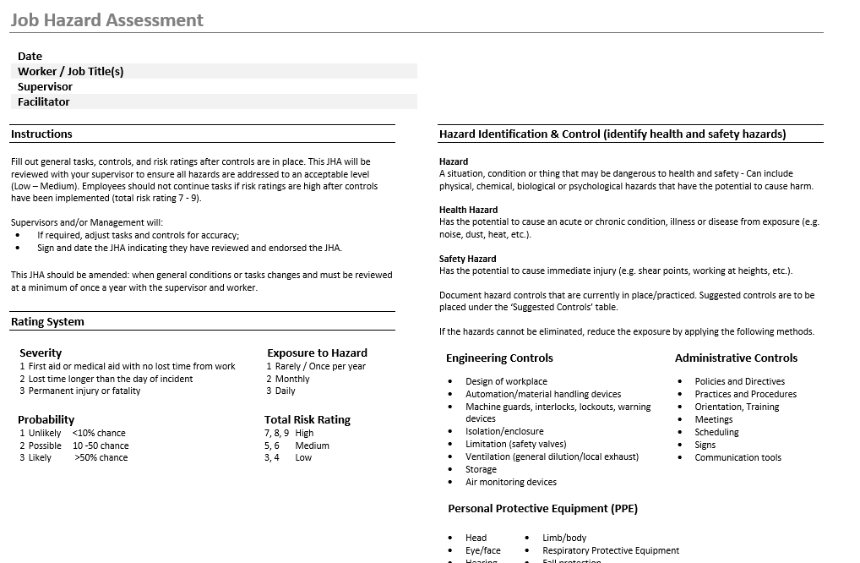
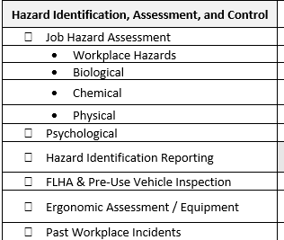
Hazard Identification, Assessment, and Control
Replace with your hazard identification, assessment and control forms / documents
Notes:
Voice-over:
“There are 4 general categories of hazards that you may be exposed to when performing your work, this is important to know so you can assess and control them to prevent injury to yourself and others.
These 4 categories of hazards are:
Biological
Chemical
Physical
Psychological
These hazards will be further described in Grey Goose’s identification, assessment and control Documents.
Your Supervisor or your Team Lead will explain to you how and where to find these Documents. These Documents consist of these forms:
Job hazard assessment
Hazard identification
Field Level Hazard Assessment (FLHA)
Pre-use vehicle inspection
Site inspections
Ergonomic assessment
Equipment Checklist
Past incident report will also be available, so you are aware of the previous known hazards and how Grey Goose, has and is, controlling them to protect: you, your co-workers, and everyone on and near the work site.”

Slide 11
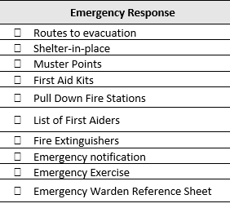
Health and Safety Orientation Checklist Emergency Response
Replace slide with your checklist
Notes:
Voice over:
“Let’s go over your emergency response.”

Slide 12
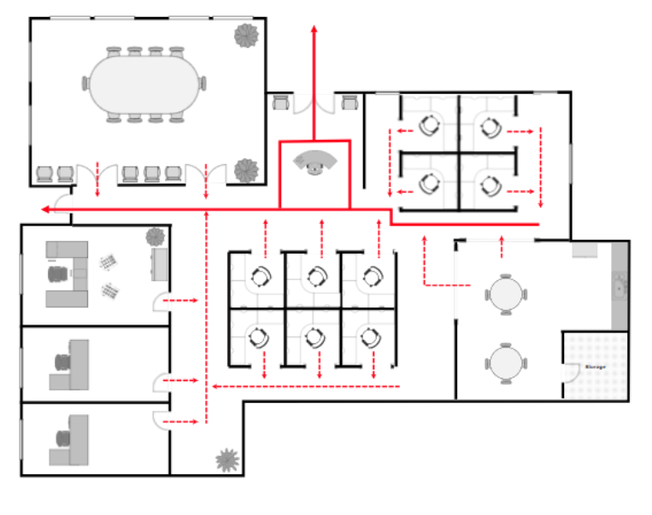
Town of Grey Goose Office Floor Map
Muster Point #1 At the Plaza Sign
Replace with your municipality.
Replace slide with your work site maps.
Muster Point #2 At the grassy knoll
 | Fire Extinguisher
 | First Aid Kit
 | Alarm Pull-down Stations
 | Health and Safety Contact List
Notes:
Voice over:
“This is your office floor map, please be familiar with the routes to the nearest exits from your workstation and the muster points.
This map identifies the location of:
First aid kit
Emergency alarm pull-down stations, and the
Fire extinguishers.
A contact list of the designated first aiders, emergency wardens and your health and safety committee representative is located on the bulletin board in the kitchen.
Emergency exercises (also known as emergency drills) will be conducted at a minimum of once a year. Follow the direction of the Emergency Warden, your Supervisor or Team Lead.
If they are unavailable during an exercise or an actual alarm immediately go to the nearest exit and proceed to the first muster point if it’s safe to do so for further instructions and or call emergency services at 9-1-1.
If you’re involved in an emergency or any incident provide a verbal and written incident report to your Supervisor as soon as possible. This also includes, reporting any unsafe or harmful work site acts that occurs or has occurred or an unsafe or harmful work site condition that exist or has existed.
Call 9-1-1 for any emergency you may encounter."

Slide 13
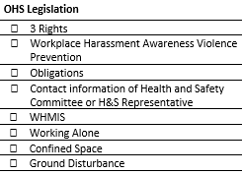
Alberta Occupational Health and Safety
Know
Participate
Refuse Dangerous Work
Notes:
Voice-over:
“As we work through the list, it is required that you are aware of your 3 rights, which are:
the right to be informed (know) of work site hazards and the means to eliminate or control those hazards,
you have the right to meaningful participation in health and safety activities pertaining to their work and work site, including the ability to express health and safety concerns, and the
you have the right to refuse dangerous work.
You must have the ability to work without being subject to discriminatory action for exercising a right or fulfilling a duty imposed by the Alberta occupational health and safety Act, Regulations or Code.”

Slide 14
Workplace Harassment and Violence Prevention
Address and Prevent violence and harassment at a work site or work-related.
Recognize it
Get assistance
Report it.
Notes:
Voice-over:
“Harassment and violence are considered hazards if there is a potential for them to exist.
Grey Goose does not tolerate harassment and acts of violence at our work sites or in our work-related activity.
It is important that we all know what it is and how to recognize it. Here’s the definition of harassment and violence:
Harassment is any single incident or repeated incidents of objectionable or unwelcome conduct, comment, bullying or action by a person that the person knows, or ought reasonably to know, will or will or would cause offence or humiliation to a worker, or adversely affects the worker’s health and safety, and includes:
Conduct, comment, bullying or action because of race, religious beliefs, colour, physical disability, mental disability, age, ancestry, place or origin, martial status, source of income, family status, gender, gender identity, gender expression and sexual orientation, and
A sexual solicitation or advance,
but excludes any reasonable conduct of an employer or supervisor in respect of the management of workers or the work site.
Violence is whether at a work site or work-related, means the threatened, attempted or actual conduct of a person that causes or is likely to cause physical or psychological injury or harm, and includes domestic or sexual violence.
You’ll be required to complete Grey Goose’s Workplace Harassment Awareness and Violence Prevention training. Your Supervisor or Team Lead will provide you more details.”

Slide 15
Obligations of Workers
Protect the health and safety of workers and other persons at or in the vicinity of the work site.
Work with your Supervisor, Employer or any other person for the purpose of protecting the health and safety of others.
Use PPE when required as per OHS legislation.
Refrain from causing or participating in harassment or violence.
Notes:
Voice over:
“As per Alberta’s occupation health and safety Act, these are your obligations, which are:
To protect the health and safety of workers and other persons at or in the vicinity of the work site.
To work with your Supervisor, Employer or any other person for the purpose of protecting the health and safety of others.
For you to use PPE when required as per OHS legislation.
You must refrain from causing or participating in harassment or violence.”

Slide 16
Obligations of Workers
Report to your Supervisor or Employer of any unsafe or harmful work site conditions that exists or has existed.
Cooperate with any person exercising a duty imposed by Alberta OHA legislation.
Comply with the Alberta OHA Act, regulations, and Code.
Notes:
Voice over:
“Your obligations also include:
Reporting any unsafe or harmful work site conditions that exists or has existed, to your Supervisor or Employer.
Cooperate with any person exercising a duty imposed by Alberta Occupational Health and Safety legislation, and
Comply with the Alberta Occupational Health and Safety Act, the regulations, and the OHS Code.”

Slide 17
Obligations of Supervisor
As far as reasonably practicable:
Ensure that the supervisor is competent to supervise every worker under the supervisor’s supervision,
Take all precautions necessary to protect the health and safety of every worker under the supervisor’s supervision,
Ensure that a worker under the supervisor’s supervision works in the manner and in accordance with the procedures and measures required by the Alberta OHS Act, Regulation, Code,
Notes:
Voice over:
“If are a Supervisor your obligations are:
As far as reasonably practicable:
Ensure that the supervisor is competent to supervise every worker under the supervisor’s supervision,
Take all precautions necessary to protect the health and safety of every worker under the supervisor’s supervision,
Ensure that a worker under the supervisor’s supervision works in the manner and in accordance with the procedures and measures required by the Alberta OHS Act, Regulation, Code”

Slide 18
Obligations of Supervisor
Ensure that every worker under the supervisor’s supervision uses all hazard controls, and properly uses or wears PPE designated or provided by the employer or required to be used or worn by the Alberta OHS Act, Regulation, Code,
Ensure that none of the workers under the supervisor’s supervision are subjected to or participate in harassment or violence at the work site.
Notes:
Voice over:
“Ensure that every worker under the supervisor’s supervision uses all hazard controls, and properly uses or wears PPE designated or provided by the employer or required to be used or worn by the Alberta OHS Act, Regulation, Code,
Ensure that none of the workers under the supervisor’s supervision are subjected to or participate in harassment or violence at the work site.”

Slide 19
Obligations of Supervisor
Supervisor’s Shall:
Advise every worker under the supervisor’s supervision of all known or reasonably foreseeable hazards to health and safety in the area where the worker is performing work.
Report to the employer a concern about an unsafe or harmful work site act that occurs or has occurred or an unsafe or harmful work site condition that exists or has existed.
Notes:
Voice over:
“Supervisor’s Shall:
Advise every worker under the supervisor’s supervision of all known or reasonably foreseeable hazards to health and safety in the area where the worker is performing work.
Report to the employer a concern about an unsafe or harmful work site act that occurs or has occurred or an unsafe or harmful work site condition that exists or has existed.”

Slide 20
Obligations of Supervisor
Supervisor’s Shall:
Cooperate with any person exercising a duty imposed by the Alberta OHS Act, Regulation, Code.
Comply with the Alberta OHS Act, Regulation, Code.
Notes:
Voice over:
“Supervisor’s Shall:
Cooperate with any person exercising a duty imposed by the Alberta OHS Act, Regulation, Code.
Comply with the Alberta OHS Act, Regulation, Code.
The latest copy of the Alberta occupational health and safety Act, Regulation, Code handbook is in the kitchen area and our intranet under the health and safety tab.”

Slide 21
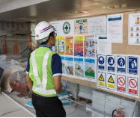
Health and Safety Representative
Replace with your structure; HSC or HS Representative
Address health and safety concerns and complaints
Health and safety recommendations
Workplace inspections
Knowledge of workplace health and safety initiatives
Suggest to customize photo with your actual work site
Notes:
Voice-over:
“Our Town of Grey Goose has a Health and Safety Representative who will be available for you to address health and safety concerns and complaints.
They’ll make health and safety recommendations to management, the prime contractor or the owner of the respective work site.
They’ll be involved with workplace inspections and will be a great source of knowledge to our workplace health and safety initiatives.”

Slide 22
Determine if this slide applicable for your employees
A worker is working alone at a work site, and assistance is not readily available if there is an emergency, or the worker is injured or ill.
Notes:
Voice-over:
“If you are planning to work alone, you must be aware that this is considered a hazard.
Working alone is defined as:
‘A worker is working alone at a work site, and assistance is not readily available if there is an emergency, or the worker is injured or ill.’
If you are working alone, you will be provided an effective communication system and regular check-in intervals will be established according to the nature of the hazards you’ll be exposed to.”

Slide 23
Workplace Hazardous Material Information System (WHMIS)
Working with or near a hazardous product, or
Performing work that involves the manufacture of a hazardous product.
You will be provided WHMIS training.
Determine if this slide applicable for your employees
Notes:
Voice-over:
“If you are:
working with or near a hazardous product, or
performing work that involves the manufacture of a hazardous product.
You’ll be provided WHMIS training.
A hazardous product is any product, mixture, material or substance classified in accordance the regulations. Your Supervisor and/or your Team Lead will provide you information on your WHMIS training requirements and site-specific procedures.”

Slide 24
Confined Space
Confined Space of Grey Goose’s code of practice outlines practices and procedures.
Determine if this slide applicable for your employees
Notes:
Voice-over:
“Confined space is another work hazard you may be exposed to.
Confined space is a restricted space which may become hazardous to a worker entering it because of:
An atmosphere that is or may be injurious by reason of oxygen deficiency or enrichment of, flammability, explosivity or toxicity,
The potential or inherent characteristics of an activity which can produce adverse or harmful consequences with the space.
A Confined Space of Grey Goose’s code of practice has been written that outlines the practices and procedures to be followed. Your Supervisor or Team Lead will provide you more details of the confined training course your may be required to complete.”

Slide 25
Ground Disturbance
Ground Disturbance Training
Identifying Ground Disturbance hazards
Prevention of unintentional contact with buried facilities
Importance of Alberta One-call
Marking schemes
Hydro-vac risks and benefits
Working near pipelines
Determine if this slide applicable for your employees
Notes:
Voice-over:
“Ground disturbance is another hazard you may be exposed to.
Disturbing the ground is when a work operation or activity on or under the existing surface results in a disturbance or displacement of the soil, but NOT if the disturbance or displacement is a result of:
Routine, minor road maintenance
Agricultural cultivation to a depth of less the 450 mm (17.7 inches) below the ground surface over a pipeline, or
Hand-digging to a depth of no more that 300 mm (11.8 inches) below the ground surface, so long it doesn’t remove cover over the buried facility.
Listed on the screen are a some of the Ground Disturbance training objectives, (pause for 5 seconds). Your Supervisor or Team Lead will provide you more details on your role and responsibilities when it comes to ground disturbance.
Please feel free to use your notes to complete the following multiple-choice questions.”

Slide 26
Multiple-choice Test
Place a check mark on the mandatory training courses.
Workplace Harassment Awareness and Violence Prevention
Health and Safety Orientation
Working Alone, when your potential work has you working alone.
None of the above.
Recommend to replace with a question that’s specific to your municipality and is a health and safety requirement.
Notes:
Voice over:
“We’re going to cover a couple of questions to verify your understanding of information we went over.
Please click on the answer or answers that best fits the question.”

Slide 27
Multiple-choice Test
Where will you find the contact list for your designated first aiders, emergency wardens and your health and safety representative?
A – In the photocopier room.
B - On the intranet in ‘SDS file’.
C – In the health and safety manual.
D – On the bulletin board in the kitchen.
Recommend to replace with a question that’s specific to your municipality and is a health and safety requirement.
Notes:
Voice over:
“Please click on the answer that best fits the question.”

Slide 28
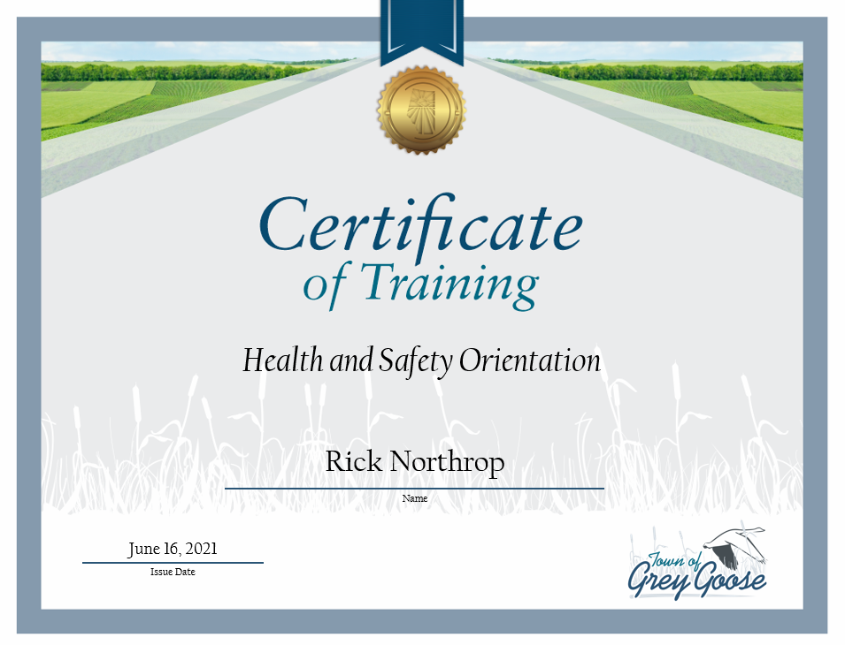
Print your certificate.
Replace with actual H&S Orientation certificate
Replace with your municipality’s position names.
Check-in with your Supervisor and Team Lead for site-specific orientation and further training requirements.
Notes:
Voice over:
“Congratulation on completing the Town of Grey Goose Health and Safety Orientation. Please notify your Supervisor that you have completed this training and check-in with both your Supervisor and Team Lead for site-specific orientation and for further training requirements.
Thank you and welcome to onboard!”

Slide 29
The End

